Slide 1
2022-2023 Welcome
Year 12 Information Evening

Slide 2
Agenda
Introduction and Vision Katherine Davis, Senior Assistant Principal
Expectations Katherine Davis, Senior AP
Personal Development Katherine Davis, Senior AP
Careers Katherine Davis, Senior AP
Tutor time programme Katherine Davis, Senior AP
A-Level courses John Marks, Head of Sixth Form
Extended Project Qualification John Marks, Head of Sixth Form
Post-18 (UCAS) John Marks, Head of Sixth Form
Supporting your child Katherine Davis, Senior AP
Questions

Slide 3
Vision for Wye Sixth Form
Continue to be a smaller than average community Sixth Form that has strong relationships and happy students
Prepare our Sixth Formers academically for their post-18 steps, whether that be University, Apprenticeships/Traineeships, or employment, without being an exam factory
Outward facing, using the best of United Learning's experience in private and state schools across England
Equip our Sixth Formers with the transferable skills for the wider world
Pastoral support from staff that know our students

Slide 4
Priorities for Year 12
To accept only the very best of themselves – TO HAVE A VISION
No limits, no barriers, no excuses to success or learning
To be fully aware of the challenges this year,
but not stressed by them
To be fully prepared for the next steps,
understanding that they are laying the foundation for lifelong success
Be competitive

Slide 5
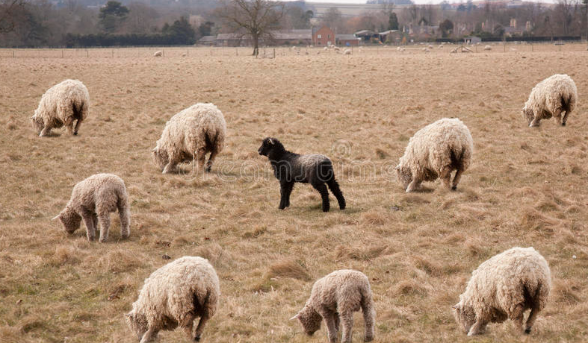
Sixth Form Expectations
3 A Levels, or equivalent, as a minimum
Guided hours- Government recommends 580 hours. We deliver above this: 641 planned learning hours, plus 158 hours for enrichment, employability and pastoral hours.
Attendance- 97%; no more than 5 school days off throughout the year.
Appearance- adhere to our dress code
Engage in the wider school life: volunteering; leadership responsibilities; House activities – DIFFERENTIATE YOURSELF

Slide 6
Attendance
Attendance is the key to success!
Our target as a school is 97% attendance. No more than 5 days per year.
Arrive by 8.30am
Signing in/out at with Ms Lindo if going into the Village
Doctor/medical/dental appointments, out of school hours

Slide 7
Dress code
Smart/casual dress code. Sixth Formers represent the Sixth Form, and the School
We do not allow:
sportswear (except for during sport)
Hoodies
faded/ripped denim
scruffy trainers, high-heeled shoes, platform shoes
cropped/strappy tops
mini skirts or shorts
Full description of dress code on our website

Slide 8
Personal Development
Co-curricular clubs run at lunchtime everyday, and after school on Tuesday and Thursday
Duke of Edinburgh’s Silver Award
Combined Cadet Force, Unit with Ashford School, every Wednesday 4-6pm
Leadership roles in Sixth Form
House Captains- run House events, fundraise
Volunteering: weekly Reading in tutor time; fortnightly in subjects

Slide 9
Careers
Study/Life Skills sessions during PSHE lessons (twice fortnightly)
All of Year 12 will receive a one to one Careers Guidance session from our independent careers advisor Chris Targett
Work Experience- during Enrichment Week, 10th-14th July 2023
All Year 12 should be undertaking work experience
Must be arranged by the student/yourselves
Must complete a WEX Placement Form
Liberty Hand – available this evening for Post-18 support

Slide 10
Tutor Time and PSHE
Tutor time everyday, 8.35-9.10am
Monday- Super-curricular
Tuesday- Guided Reading Volunteering, or Unifrog
Wednesday- Guided Reading Volunteering, or Unifrog
Thursday- Briefing (e.g. external speakers)
Friday- Presentation preparation
All of Sixth Form have two PSHE lessons a fortnight, focusing on Life Skills. Additionally, Sixth Form participate in Drop Down Days every half term including, for example, Sex Education, Study Skills

Slide 11
A Levels
JMA to edit
Most students do three A Level courses. We teach the following courses:
Guided hours- Government recommends 580 hours. We deliver above this: 641 planned learning hours
For each subject, students should have a folder containing:
Independent learning log
Subject starter pack with
useful links & suggestions

Slide 12
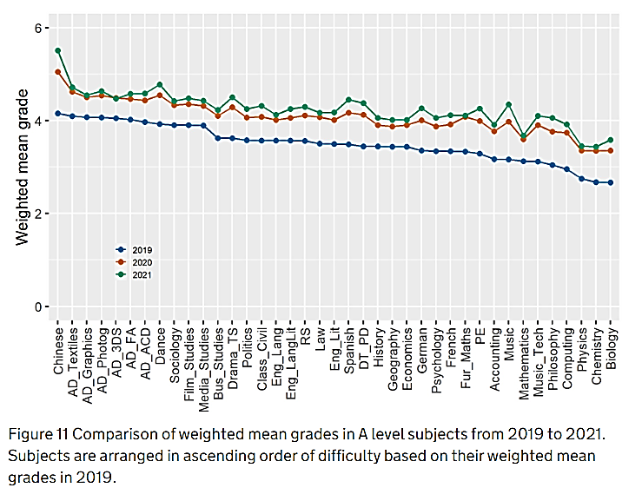
https://www.gov.uk/government/publications/an-investigation-of-inter-subject-comparability-in-gcses-and-a-levels-in-summer-2021/an-investigation-of-inter-subject-comparability-in-gcses-and-a-levels-in-summer-2021

Slide 13
The EPQ
an A-level standard standalone qualification
taken as an extension of other A levels
worth half an A-level (28 UCAS points)
it's recognised by universities and employers
many universities make lower A-level offers to students
plan and carry out research on a topic that they've chosen produce a written report, an artefact or a production
Students become & demonstrate that they become:
more critical, reflective and independent learners
develop and apply decision-making and problem-solving skills
increase their planning, research, analysis, synthesis, evaluation and presentation skills
demonstrate creativity, initiative and enterprise
Last Year’s students...

Slide 14
Independent Study
JMA to edit
Study Periods to be used for:
completion of homework;
independent review of course content;
Super-curricular research;
completion of UCAS/Unifrog;
preparing for tutor time presentations;
Volunteering
Homework: students should spend the same amount of time in independent study as taught time in the classroom
e.g. 6 lessons of Maths per week, should mean 6 study periods spent on independent study for Maths

Slide 15
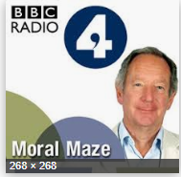
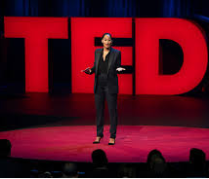
Super-Curricular -

Slide 16
Super-Curricular cont.
Books e.g. “Very short introduction to… “ short books of c.150 pages, £2.39
Isaac – (Physics)
Khan Academy
iTu – iTunes University
(for apple devices)
edX
MOOCs – massive open online courses – send you reminders each week
Coursea.org
Academic competitions
Visits
FutureLearn
Look for, but don’t be limited by your course’s reading list
@univstaircase12

Slide 17
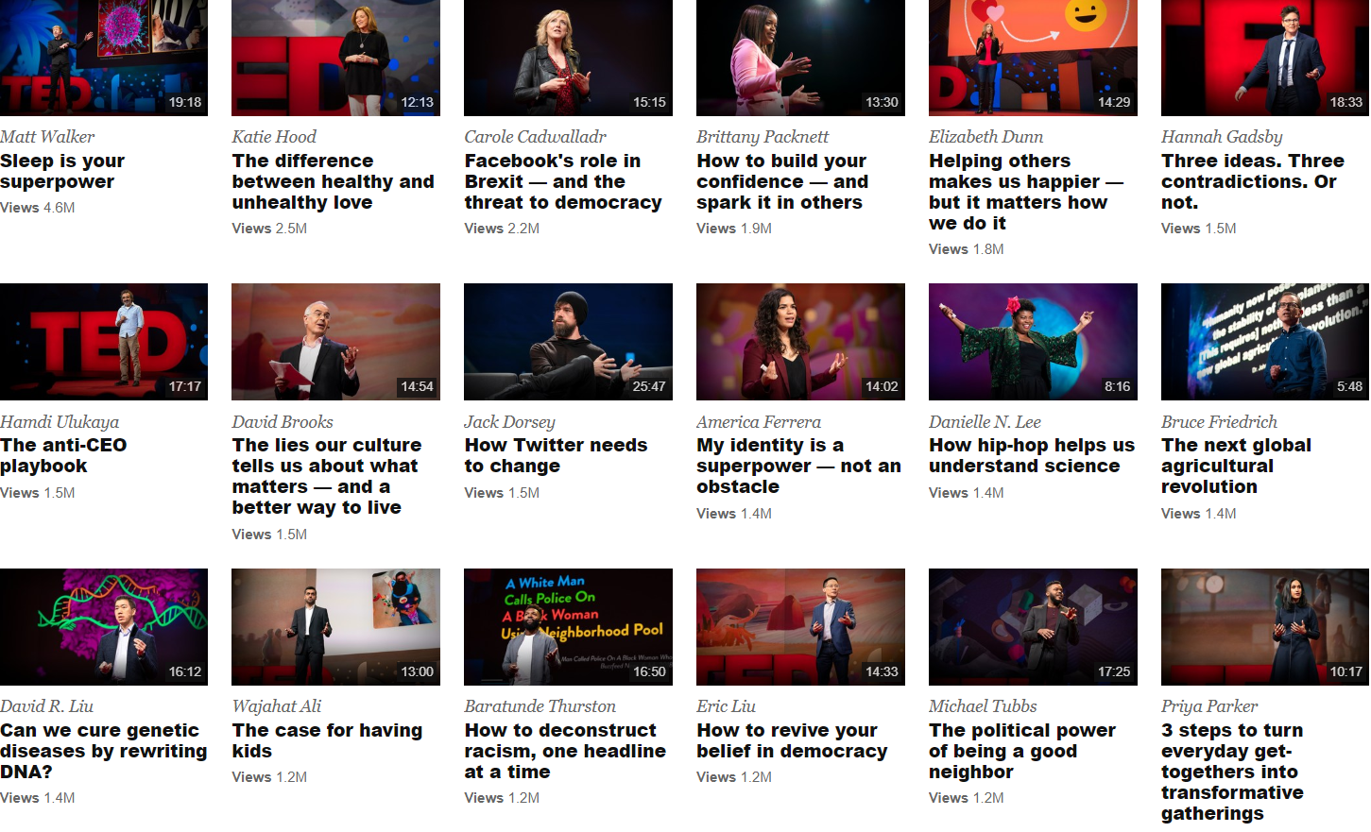
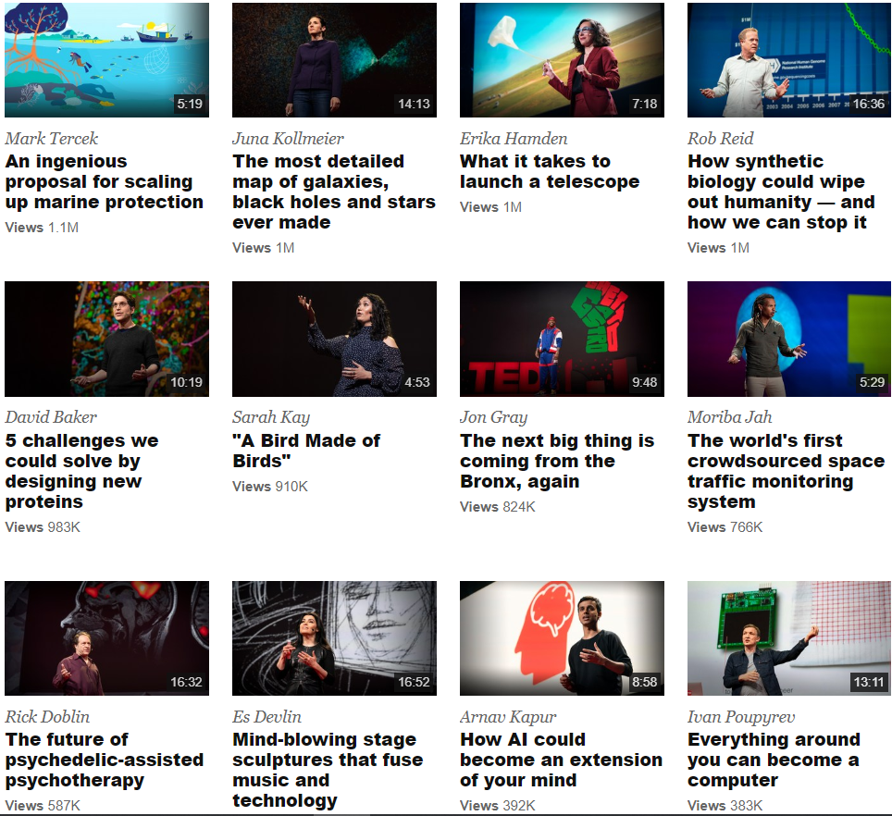

Slide 18
Independent Study
All Sixth Form students have been issued a Chromebook
Homework is set via Satchel One
Some subjects use Teams or One Note for lessons and work submission
If students miss a lesson, they are expected to catch up

Slide 19
Independent Study-Revision Timetables
Tests & mocks matter!
A revision timetable will help your son or daughter plan their time and achieve the most - avoid last minute panics and cramming.
Be honest and realistic – do they work best in the mornings, afternoons or evenings?

Slide 20
UCAS
JMA to edit
UCAS is how you apply to University
Sixth Form students start preparing Personal Statements, on Unifrog, for their UCAS applications in summer 2023.
Some Art Colleges & foundation courses
have their own application processes
Deadline for UCAS submissions is mid December 2023 for September 2024 entry, early October if applying to Oxbridge or Vet/Dentistry/Medicine.
Even if your child doesn’t want to go to university, the preparation of writing a Personal Statement is very useful.

Slide 21
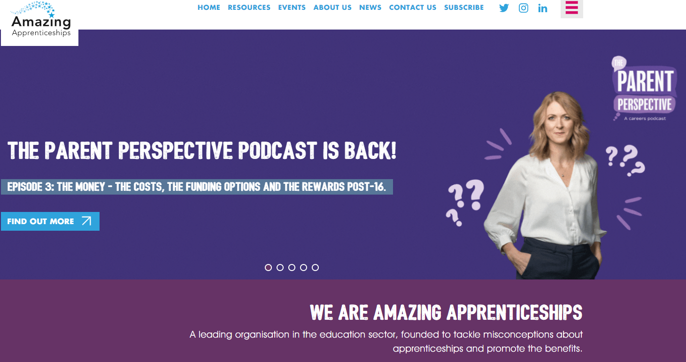
Other routes
If your child is interested in a degree-apprenticeship an apprenticeship or traineeship, we can also help to support

Slide 22
How well is my child doing?
From the mock exams, you will receive the following:
Current Grades – This indicates the level they are currently working at.
Target Grades – This is an aspirational grade based on their Key Stage 2 SATS scores. If they achieve their target grade, they are making excellent progress.
Predicted Grade – This is the grade we think they will achieve at the end of the course.
Learning Indicator – This is an effort grade. It can be either Poor, Requires Improvement, Good or Excellent.

Slide 23
Support - what can you do?
Provide a quiet space for students to work
Show interest in what they are doing
Try to resist giving students the impression that a subject doesn't matter e.g. 'I was never any good at science'.
Correct language – if your son/daughter says they cannot do it, qualify this – they cannot do it yet!
Be familiar with deadlines – put these on the family calendar / Outlook etc.
Look at work, ask questions, help with
a revision timetable
Use your own (positive) experiences
Ensure that students know how much
cleverer they get when they work hard

Slide 24
Support - where else can you turn?
If a student has an issue with a subject, or an issue affecting their studies, we can help to provide support and encouragement.
Please contact Form Tutors in the first instance.
12A- Melanie Cusani- melanie.Cusani@wyeschool.org.uk
12B- Julie Apps- Julie.apps@wyeschool.org.uk
If your child needs financial assistance via the 16-19 Bursary Fund, please visit our School website, Sixth Form, for more information

Slide 25
Year 12 Key Dates
2nd November- Sixth Form Open Evening, 5.30-7pm. Students to attend as part of volunteering.
23rd January- Parents’ Evening, in person
27th January- 3rd February- Mid Year Assessments
13th -19th June – End of Year Exams

Slide 27
Questions
Please feel free to stay for individual questions.
Good evening!

